Slide 1
Data Preprocessing
Data Preprocessing: An Overview
Data Quality
Major Tasks in Data Preprocessing
Data Cleaning
Data Integration
Data Reduction
Data Transformation and Data Discretization
Summary
1

Slide 2
Data Quality: Why Preprocess the Data?
Measures for data quality: A multidimensional view
Accuracy: correct or wrong, accurate or not
Completeness: not recorded, unavailable, …
Consistency: some modified but some not, dangling, …
Timeliness: timely update?
Believability: how trustable the data are correct?
Interpretability: how easily the data can be understood?

Slide 3
Major Tasks in Data Preprocessing
Data cleaning
Fill in missing values, smooth noisy data, identify or remove outliers, and resolve inconsistencies
Data integration
Integration of multiple databases, data cubes, or files
Data reduction
Dimensionality reduction
Numerosity reduction
Data compression
Data transformation and data discretization
Normalization
Concept hierarchy generation

Slide 4
Data Preprocessing
Data Preprocessing: An Overview
Why ? Ans: Data Quality
Major Tasks in Data Preprocessing
Data Cleaning
Data Integration
Data Reduction
Data Transformation and Data Discretization
Summary
4

Slide 5
Data Cleaning
Data in the Real World Is Dirty: Lots of potentially incorrect data, e.g., instrument faulty, human or computer error, transmission error
incomplete: lacking attribute values, lacking certain attributes of interest, or containing only aggregate data
e.g., Occupation=“ ” (missing data)
noisy: containing noise, errors, or outliers
e.g., Salary=“−10” (an error)
inconsistent: containing discrepancies in codes or names, e.g.,
Age=“42”, Birthday=“03/07/2010”
Was rating “1, 2, 3”, now rating “A, B, C”
discrepancy between duplicate records
Intentional (e.g., disguised missing data)
Jan. 1 as everyone’s birthday?

Slide 6
Incomplete (Missing) Data
Data is not always available
E.g., many tuples have no recorded value for several attributes, such as customer income in sales data
Missing data may be due to
equipment malfunction
inconsistent with other recorded data and thus deleted
data not entered due to misunderstanding
certain data may not be considered important at the time of entry
not register history or changes of the data
Missing data may need to be inferred

Slide 7
How to Handle Missing Data?
Ignore the tuple: usually done when class label is missing (when doing classification)—not effective when the % of missing values per attribute varies considerably
Fill in the missing value manually: tedious + infeasible?
Fill in it automatically with
a global constant : e.g., “unknown”, a new class?!
the attribute mean
the attribute mean for all samples belonging to the same class: smarter

Slide 8
Noisy Data
Noise: random error or variance in a measured variable
Incorrect attribute values may be due to
faulty data collection instruments
data entry problems
data transmission problems
technology limitation
inconsistency in naming convention
Other data problems which require data cleaning
duplicate records
incomplete data
inconsistent data
8
Notes:
8

Slide 9
How to Handle Noisy Data?
Binning
first sort data and partition into (equal-frequency) bins
then one can smooth by bin means, smooth by bin median, smooth by bin boundaries, etc.
Regression
smooth by fitting the data into regression functions
Clustering
detect and remove outliers
Combined computer and human inspection
detect suspicious values and check by human (e.g., deal with possible outliers)

Slide 10
Data Cleaning as a Process
Data discrepancy detection
Use metadata (e.g., domain, range, dependency, distribution)
Check field overloading
Check uniqueness rule, consecutive rule and null rule
Data scrubbing: use simple domain knowledge (e.g., postal code, spell-check) to detect errors and make corrections
Data auditing: by analyzing data to discover rules and relationship to detect violators (e.g., correlation and clustering to find outliers)
Data migration and integration
Data migration tools: allow transformations to be specified
ETL (Extraction/Transformation/Loading) tools: allow users to specify transformations through a graphical user interface

Slide 11
Data Preprocessing
Data Preprocessing: An Overview
Data Quality
Major Tasks in Data Preprocessing
Data Cleaning
Data Integration
Data Reduction
Data Transformation and Data Discretization
Summary
11

Slide 12
Data Integration
Data integration:
Combines data from multiple sources into a coherent store
Schema integration: e.g., A.cust-id ≡ B.cust-#
Integrate metadata from different sources
Entity identification problem:
Identify real world entities from multiple data sources, e.g., Bill Clinton = William Clinton
Detecting and resolving data value conflicts
For the same real world entity, attribute values from different sources are different
Possible reasons: different representations, different scales, e.g., metric vs. British units
12

Slide 13
Handling Redundancy in Data Integration
Redundant data occur often when integration of multiple databases
Object identification: The same attribute or object may have different names in different databases
Derivable data: One attribute may be a “derived” attribute in another table, e.g., annual revenue
Redundant attributes may be able to be detected by correlation analysis and covariance analysis
Careful integration of the data from multiple sources may help reduce/avoid redundancies and inconsistencies and improve mining speed and quality
13

Slide 14
Data Preprocessing
Data Preprocessing: An Overview
Data Quality
Major Tasks in Data Preprocessing
Data Cleaning
Data Integration
Data Reduction
Data Transformation and Data Discretization
Summary
14
Notes:
14

Slide 15
Data Reduction Strategies
Data reduction: Obtain a reduced representation of the data set that is much smaller in volume but yet produces the same (or almost the same) analytical results
Why data reduction? — A database/data warehouse may store terabytes of data. Complex data analysis may take a very long time to run on the complete data set.
Data reduction strategies
Dimensionality reduction, e.g., remove unimportant attributes
Feature subset selection, feature creation
Numerosity reduction (some simply call it: Data Reduction)
Regression and Log-Linear Models
Histograms, clustering, sampling
Data cube aggregation
Data compression

Slide 16
Data Reduction 1: Dimensionality Reduction
Curse of dimensionality
When dimensionality increases, data becomes increasingly sparse
Density and distance between points, which is critical to clustering, outlier analysis, becomes less meaningful
The possible combinations of subspaces will grow exponentially
Dimensionality reduction
Avoid the curse of dimensionality
Help eliminate irrelevant features and reduce noise
Reduce time and space required in data mining
Allow easier visualization
Dimensionality reduction techniques
Wavelet transforms
Principal Component Analysis
Supervised and nonlinear techniques (e.g., feature selection)
Notes:
16

Slide 17
Attribute Creation (Feature Generation)
17
Create new attributes (features) that can capture the important information in a data set more effectively than the original ones
Three general methodologies
Attribute extraction
Domain-specific
Mapping data to new space (see: data reduction)
E.g., Fourier transformation, wavelet transformation, manifold approaches (not covered)
Attribute construction
Combining features
Data discretization
Notes:
17

Slide 18
Data Reduction 2: Numerosity Reduction
Reduce data volume by choosing alternative, smaller forms of data representation
Parametric methods Assume the data fits some model, estimate model parameters, store only the parameters, and discard the data (except possible outliers)
Non-parametric methods
Do not assume models
Major families: histograms, clustering, sampling, …

Slide 19
Histogram Analysis
Divide data into buckets and store average (sum) for each bucket
Partitioning rules:
Equal-width: equal bucket range
Equal-frequency (or equal-depth)

Slide 20
Data Reduction 3: Data Compression
String compression
There are extensive theories and well-tuned algorithms
Typically lossless, but only limited manipulation is possible without expansion
Audio/video compression
Typically lossy compression, with progressive refinement
Sometimes small fragments of signal can be reconstructed without reconstructing the whole
Time sequence is not audio
Typically short and vary slowly with time
Dimensionality and numerosity reduction may also be considered as forms of data compression
Notes:
20

Slide 21
Data Compression
Original Data
Compressed
Data
lossless
Original Data
Approximated
lossy
Notes:
21

Slide 22
Data Preprocessing
Data Preprocessing: An Overview
Data Quality
Major Tasks in Data Preprocessing
Data Cleaning
Data Integration
Data Reduction
Data Transformation and Data Discretization
Summary
Notes:
22

Slide 23
Data Transformation
A function that maps the entire set of values of a given attribute to a new set of replacement values s.t. each old value can be identified with one of the new values
Methods
Smoothing: Remove noise from data
Attribute/feature construction
New attributes constructed from the given ones
Aggregation: Summarization, data cube construction
Normalization: Scaled to fall within a smaller, specified range
min-max normalization
z-score normalization
normalization by decimal scaling
Discretization: Concept hierarchy climbing
Notes:
23

Slide 24
Normalization
Min-max normalization:
Z-score normalization (μ: mean, σ: standard deviation):
Normalization by decimal scaling
Where j is the smallest integer such that Max(|ν’|) < 1

Slide 25
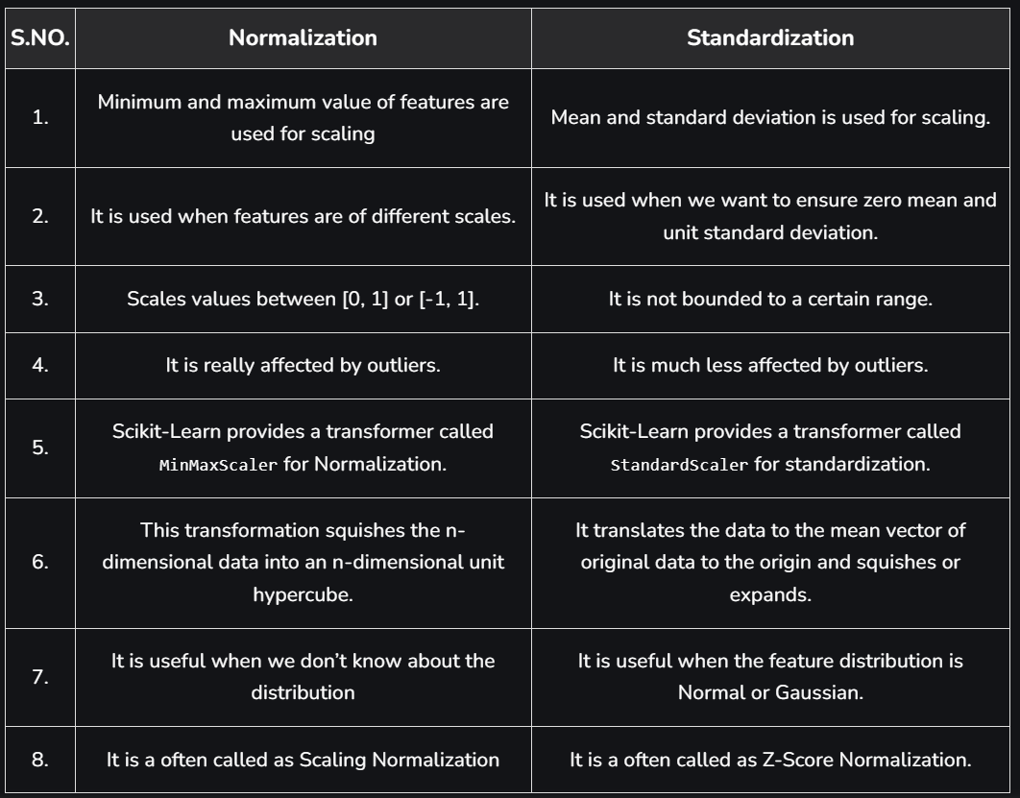

Slide 26
Discretization
Discretization: Divide the range of a continuous attribute into intervals
Interval labels can then be used to replace actual data values
Reduce data size by discretization
Typical methods: All the methods can be applied recursively
Binning
Histogram analysis
Clustering analysis
Decision-tree analysis

Slide 27
Simple Discretization: Binning
Equal-width (distance) partitioning
Divides the range into N intervals of equal size: uniform grid
if A and B are the lowest and highest values of the attribute, the width of intervals will be: W = (B –A)/N.
The most straightforward, but outliers may dominate presentation
Skewed data is not handled well
Equal-depth (frequency) partitioning
Divides the range into N intervals, each containing approximately same number of samples
Good data scaling
Managing categorical attributes can be tricky

Slide 28
Concept Hierarchy Generation for Nominal Data
Specification of a partial/total ordering of attributes explicitly at the schema level by users or experts
street < city < state < country
Specification of a hierarchy for a set of values by explicit data grouping
{Urbana, Champaign, Chicago} < Illinois
Specification of only a partial set of attributes
E.g., only street < city, not others
Automatic generation of hierarchies (or attribute levels) by the analysis of the number of distinct values
E.g., for a set of attributes: {street, city, state, country}

Slide 29
Automatic Concept Hierarchy Generation
Some hierarchies can be automatically generated based on the analysis of the number of distinct values per attribute in the data set
The attribute with the most distinct values is placed at the lowest level of the hierarchy
Exceptions, e.g., weekday, month, quarter, year
country
15 distinct values
province_or_ state
365 distinct values
city
3567 distinct values
street
674,339 distinct values

Slide 30
Data Preprocessing
Data Preprocessing: An Overview
Data Quality
Major Tasks in Data Preprocessing
Data Cleaning
Data Integration
Data Reduction
Data Transformation and Data Discretization
Summary
Notes:
30

Slide 31
Summary
Data quality: accuracy, completeness, consistency, timeliness, believability, interpretability
Data cleaning: e.g. missing/noisy values, outliers
Data integration from multiple sources:
Entity identification problem
Remove redundancies
Detect inconsistencies
Data reduction
Dimensionality reduction
Numerosity reduction
Data compression
Data transformation and data discretization
Normalization
Concept hierarchy generation

Slide 32
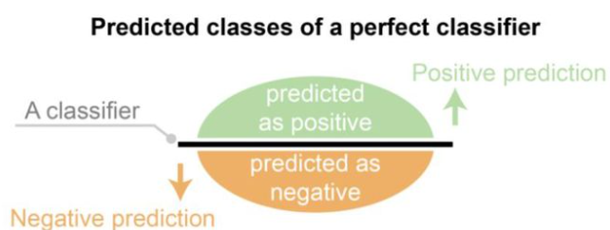
Binary Classifier
A binary classifier produces output with two class values or labels, such as Yes/No, 1/0, Positive/Negative for given input data
A dataset used for performance evaluation is called a test dataset. Observed labels are used to compare with the predicted labels for performance evaluation after classification
The predicted labels will be exactly the same if the performance of a classifier is perfect, But it is uncommon to be able to develop a perfect classifier

Slide 33
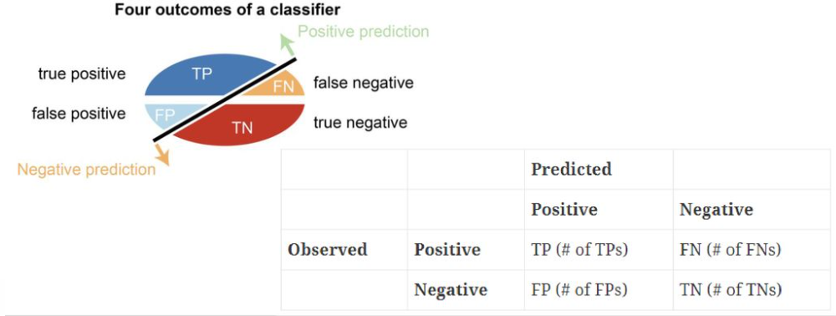

Slide 34
Confusion Matrix
A confusion matrix is formed from the four outcomes produced as a result of binary classification
True positive (TP): correct positive prediction
False positive (FP): incorrect positive prediction
True negative (TN): correct negative prediction
False negative (FN): incorrect negative prediction

Slide 35
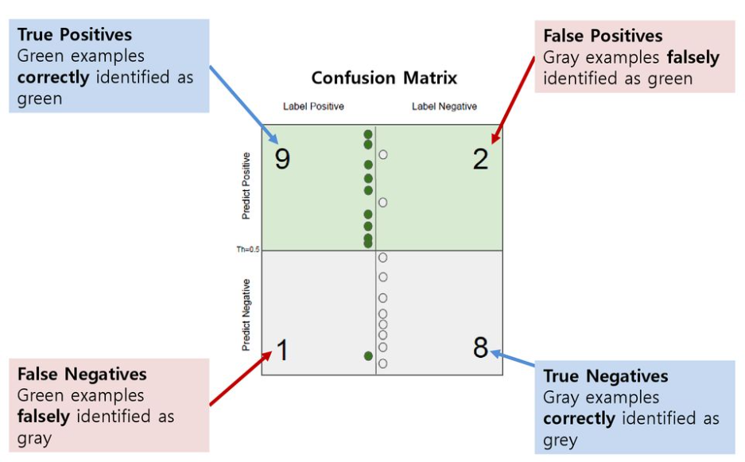

Slide 36
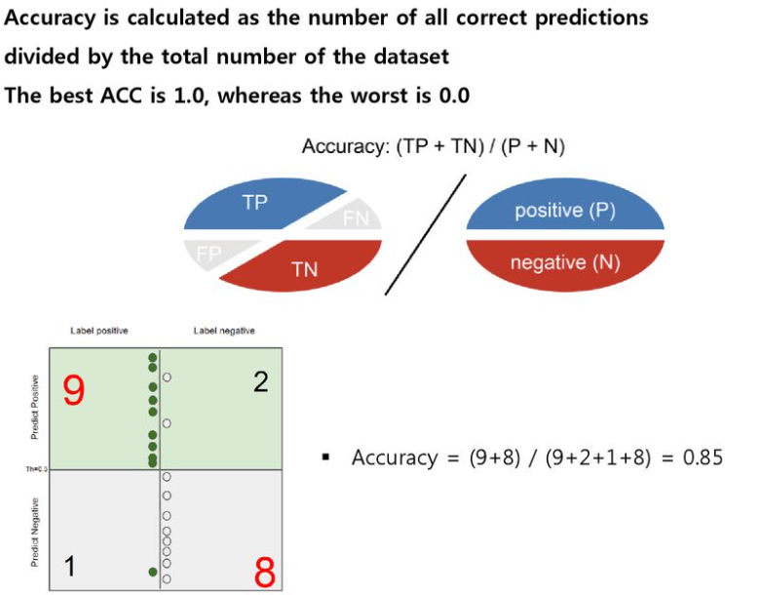
Accuracy

Slide 37
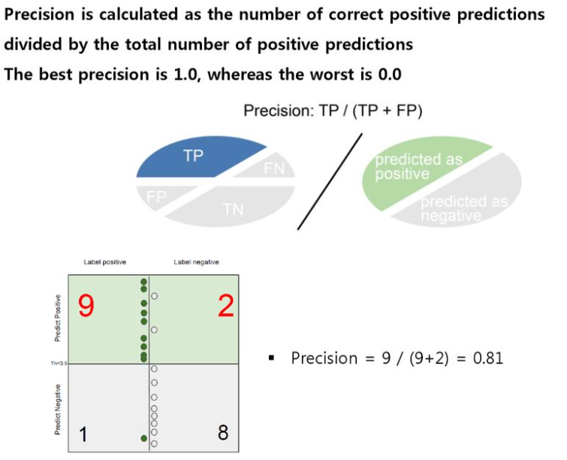
Precision

Slide 38
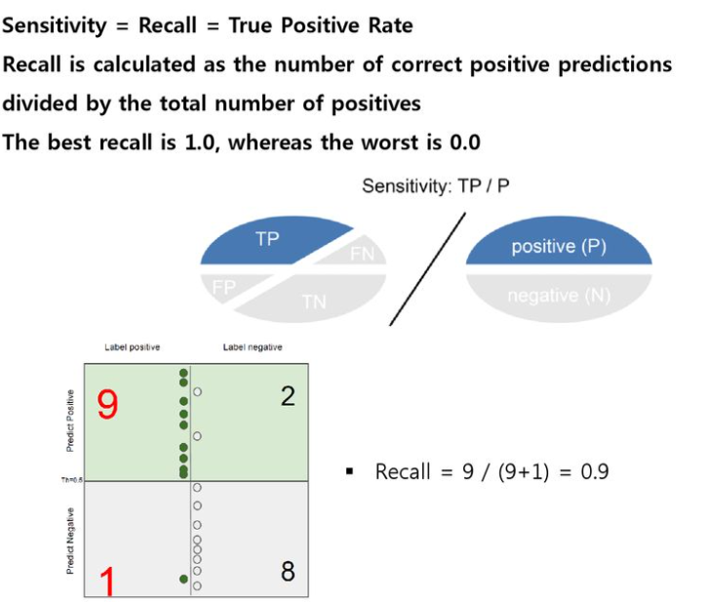
Recall (Probability of detection)
TPR – True positive Rate

Slide 39
